Slide 1
MINI PROJECT ON IMAGE FILTERING

Slide 2
This project is done by
-K.Guruvardhini
21FE1A0471

Slide 3
Contents
Introduction
Purpose
Requirements Specification
Software Requirements & Hardware Requirements
Software Description
About the Project
Project Description
Problem Definition
Project Overview
Image filters Description
Types of Filters
Output screens
Conclusions
Bibliography
o

Slide 4
ABSTRACT
Image processing is an area consisting of different phases for manipulating pixels of an image.
Image processing is an enhancement of images which affects an image's pictorial view.
Image processing is the process of converting an image into digital form and then performing various operations on it, such as enhancing the image or extracting useful information.
Image filtering is a technique for altering the scale, shape, colour, depth, smoothness, and other aspects of images.

Slide 5
Essentially, it modifies the pixels of an image to transform it into the desired form using various types of graphical editing methods via graphic design and editing software.
In Image Improvement, the removal of noise is very necessary and filters are used for this.
This project introduces some filters that will give you a better version of your image. Using different kinds of filters provides you noise free images.

Slide 6
INTRODUCTION
Image filtering is a step in the image pre-processing process.
In this project, we are trying to solve a problem with the image filters which are used to increase or decrease noises present in images, also dealing with hue.
There are different kinds of image noise, we are providing some filters that will help to reduce/increase the noise based on user requirements.

Slide 7
PURPOSE
The main purpose of this project is to reduce the noise of the images.
It helps in reducing the time to apply multiple filters
It uses various filters at a time and provide the output for input.
It excludes human efforts and saves time and resources.

Slide 8
Requirements Specification
SOFTWARE REQUIREMENTS:
Software requirements deal with defining software resource requirements that need to be installed on a computer to provide optimal functioning of an application
Operating System: Windows7/8/10/11
Back End: OpenCV , NumPy
Language: Python
Platform used: Jupyter notebook
HARDWARE REQUIREMENTS:
Processor: Intel dual core i3/i5/i7
RAM: 4 GB

Slide 9

TECHNOLOGIES USED:
Python
Python is an interpreted high-level general-purpose programming language.
Its design philosophy emphasizes code readability with its use of significant indentation.
Its language constructs as well as its object-oriented approach aim to help programmers write clear, logical code for small and large-scale project

Slide 10

OpenCV
OpenCV (Open Source Computer Vision Library) is a library of programming functions mainly aimed at real-time computer vision.
Originally developed by Intel, it was later supported by Willow Garage then Itseez (which was later acquired by Intel).
The library is cross-platform and free for use under the open-source Apache 2 License. Starting with 2011, OpenCV features GPU acceleration for real-time operations

Slide 11

NumPy
NumPy is a Python library used for working with arrays.
It also has functions for working in domain of linear algebra, Fourier transform, and matrices.
NumPy was created in 2005 by Travis Oliphant. It is an open source project and you can use it freely.
NumPy stands for Numerical Python.

Slide 12
ABOUT THE PROJECT
Image filtering is changing the appearance of an image by altering the colours of the pixels.
Increasing the contrast as well as adding a variety of special effects to images are some of the results of applying filters.
In order to obtain a high success rate of OCR (optical character recognition) performed on text images, the main target of filters is, however, to reduce the noise around characters in the image.

Slide 13
PROJECT DESCRIPTION
PROBLEM DEFINITION:
When we capture a photo through the camera, we might not get a clear or we can say noise free image.
As a consequence of image capture, image noise is an unavoidable side-effect, more simply understood as inaudible, yet inevitable fluctuations.
In a digital camera, it can produce image noise if the light that reaches the lens is misaligned with the sensors

Slide 14
PROJECT SPECIFICATIONS:
In the world of computer vision, image filtering is used to modify images. These modifications essentially allow you to clarify an image in order to get the information you want.
This could involve anything from extracting edges from an image, blurring it, or removing unwanted objects. There are, of course, lots of reasons why you might want to use image filtering to modify an image.

Slide 15
IMAGE FILTER DESCRIPTION:
Image filtering is changing the appearance of an image by altering the colors of the pixels.
Increasing the contrast as well as adding a variety of special effects to images are some of the results of applying filters.

Slide 16
FILTERS USED :-
Blur image
Grey scaling Image
Grey blur Image
Motion Blur Image
Cartoon image
Edge Detection
Edges
Dilation Image
Erosion Image
Negative Image

Slide 17
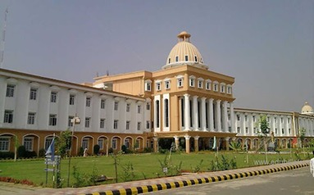
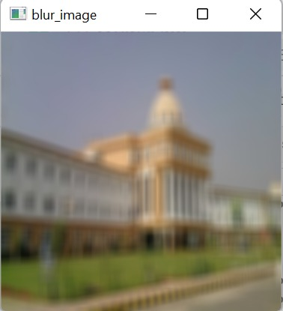
BLUR IMAGE OpenCV-Python is a library of Python bindings designed to solve computer vision problems. cv2.blur() method is used to blur an image using the normalized box filter.

Slide 18

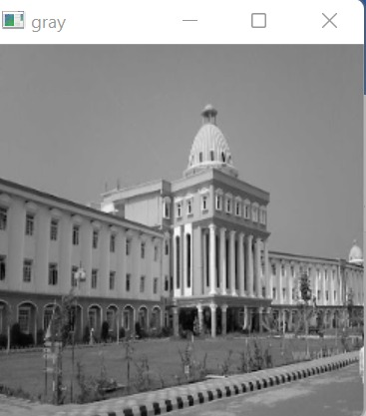
GRAY IMAGE: Gray scaling is the process of converting an image from other color spaces e.g. RGB, CMYK, HSV, etc. to shades of ray. It varies between complete black and complete white. original : output:

Slide 19
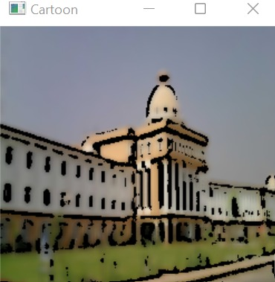
CARTOON Image cartoon frames don’t contain so many variants of color and those frames also contain dark edges of each object. There’re lots of ways to do that, but we’re going to use color quantization and the adaptive threshold technique. Using this technique, we can achieve a very great result.

Slide 20
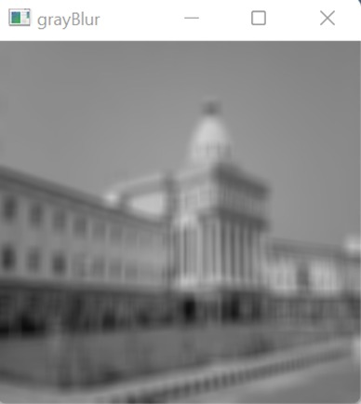
GRAY BLUR IMAGE Blurring refers to making the image less clear or distinct. The Median Filter often used to remove noise from an image or signal. Median filtering is very widely used in digital image processing because, under certain conditions, it preserves edges while removing noise.

Slide 21
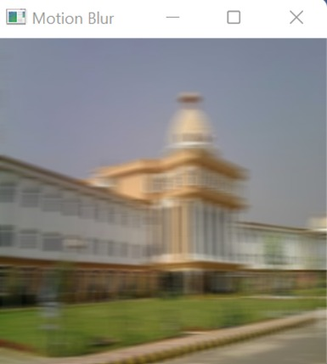
MOTION BLUR IMAGE When we apply the motion blurring effect, it will look like you captured the picture while moving in a particular direction. For example, you can make an image look like it was captured from a moving car.

Slide 22
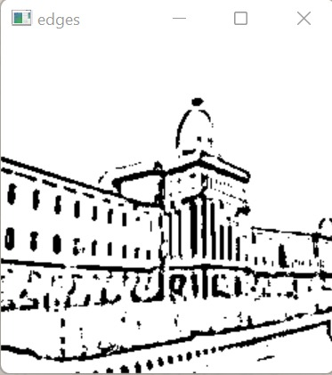
EDGES Edges are characterized by sudden changes in pixel intensity. To detect edges, we need to go looking for such changes in the neighbouring pixels.

Slide 23
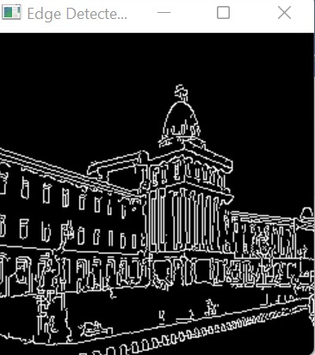
EDGE DETECTION IMAGE Edge detection is an image processing technique, which is used to identify the boundaries (edges) of objects, or regions within an image. Edges are among the most important features associated with images. We come to know of the underlying structure of an image through its edges.

Slide 24
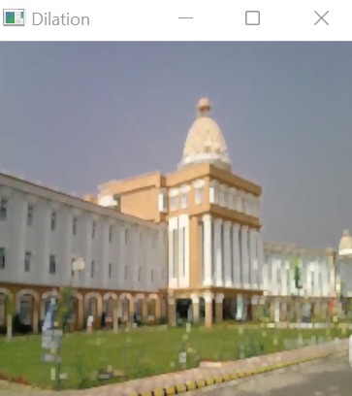
DILATION In the Dilation, it increases the object area. The Erosion can remove the white noises, but it also shrinks our image, so after Erosion, if Dilation is performed, we can get better noise removal results. The Dilation can also be used to joins some broken parts of an object.

Slide 25
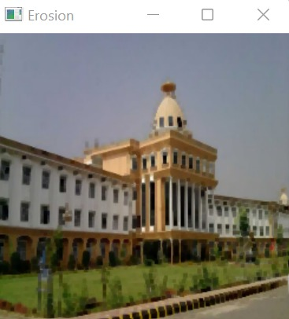
EROSION the Erosion, it erodes away the boundaries of foreground objects. It is used to remove small white noises from the images. Erosion can also be used to detach two connected images.

Slide 26
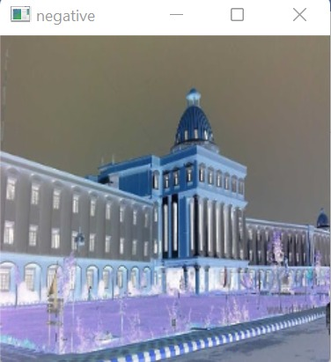
NEGATIVE Negatives are normally used to make positive prints on photographic paper by projecting the negative onto the paper with a photographic enlarger or making a contact print. The paper is also darkened in proportion to its exposure to light, so a second reversal results which restores light and dark to their normal order.

Slide 27
CONCLUSION
Image filtering has a wide range of applications including edge detection, removing noise, sharpening and smoothing.
Image filtering has brought an evolutionary change in the field of image processing.
There are many more complex modifications you can make to the images.
In this project, we have used some filters to the image and we have get accurate solutions for the inputs.
By using filters we have decreased the noises of the image.
we can apply multiple filters at a time and we can decrease the time to apply multiple filters.
We can excludes human efforts and saves time and resources.

Slide 28
BIBLIOGRAPHY
Research Gate – https://www.researchgate.net/publication/349811111_Image_Processing_with_Python_An_Introduction
Javatpoint - https://www.javatpoint.com/opencv-image-filters

Slide 29
THANK YOU

